Slide 1
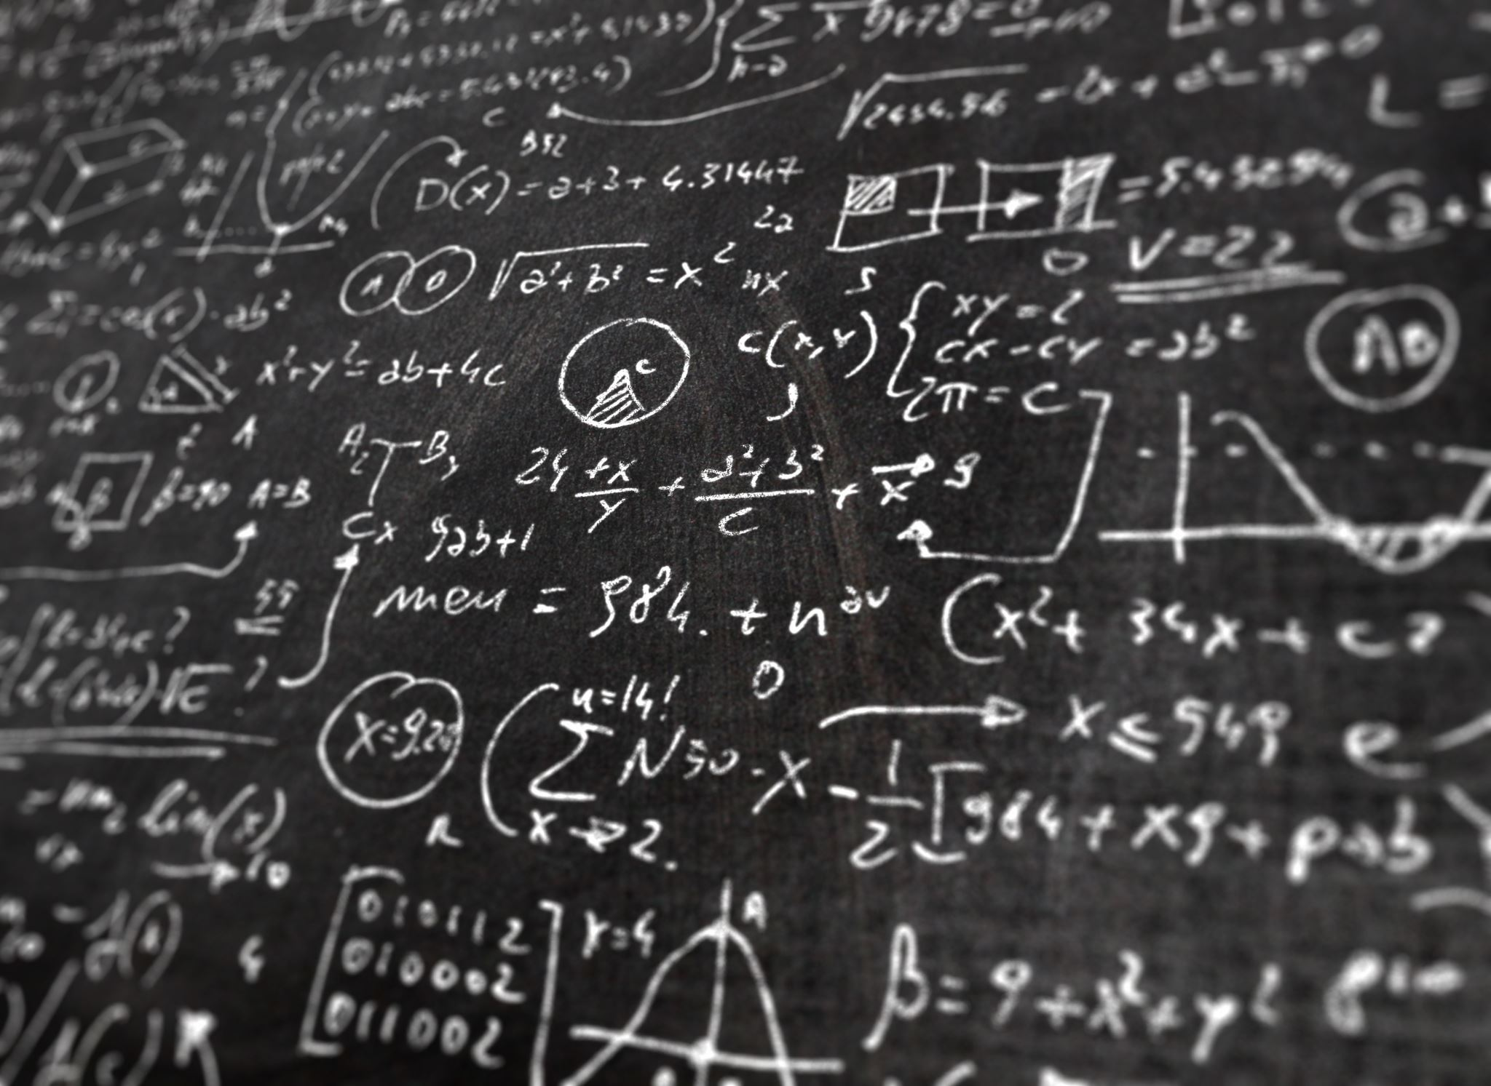
Applied Physics PHYS204 Final Course Project
Chandra Atchley
December 2022

Slide 2
Introduction
Physics is an intriguing subject. It helps us begin to understand how the world around us works! The studying of Physics also helps expand your problem-solving skills and critical thinking skills.
Throughout this final course presentation, you will find experiments and data analysis from free-fall motion, conservation of energy, rotational motion, and the hall effect.

Slide 3
MATERIALS LIST
The materials used, as well as the software, during an experiment is key to the process.
It will display a concise description of what is used and why it is used.

Slide 4
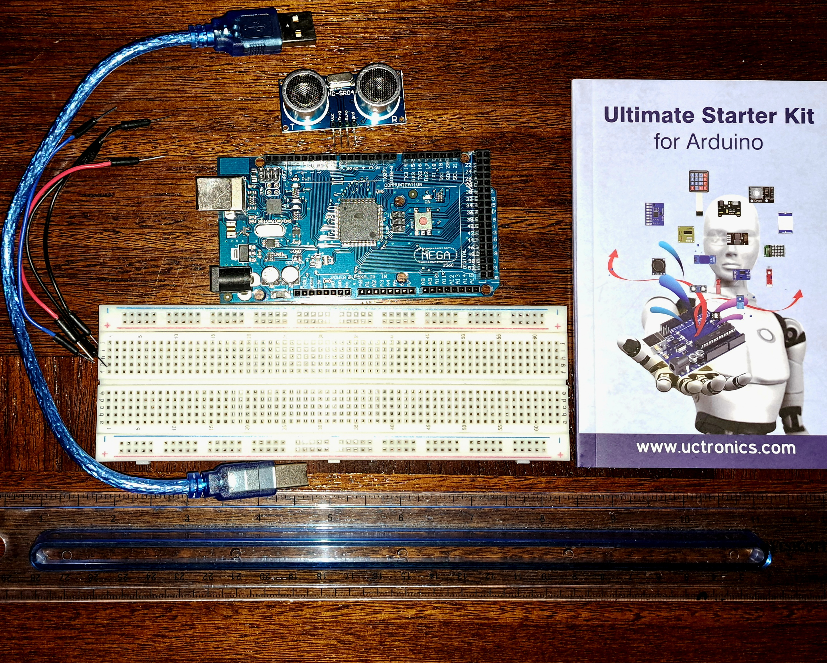
MATERIALS LIST
Arduino Mega 2560
Ultrasonic sensor HC-SR04
Male to Male Wires
Breadboard
USB cable to connect Arduino
Ruler or tape measurer
Object to act as obstacle and/or undergo free-fall

Slide 5
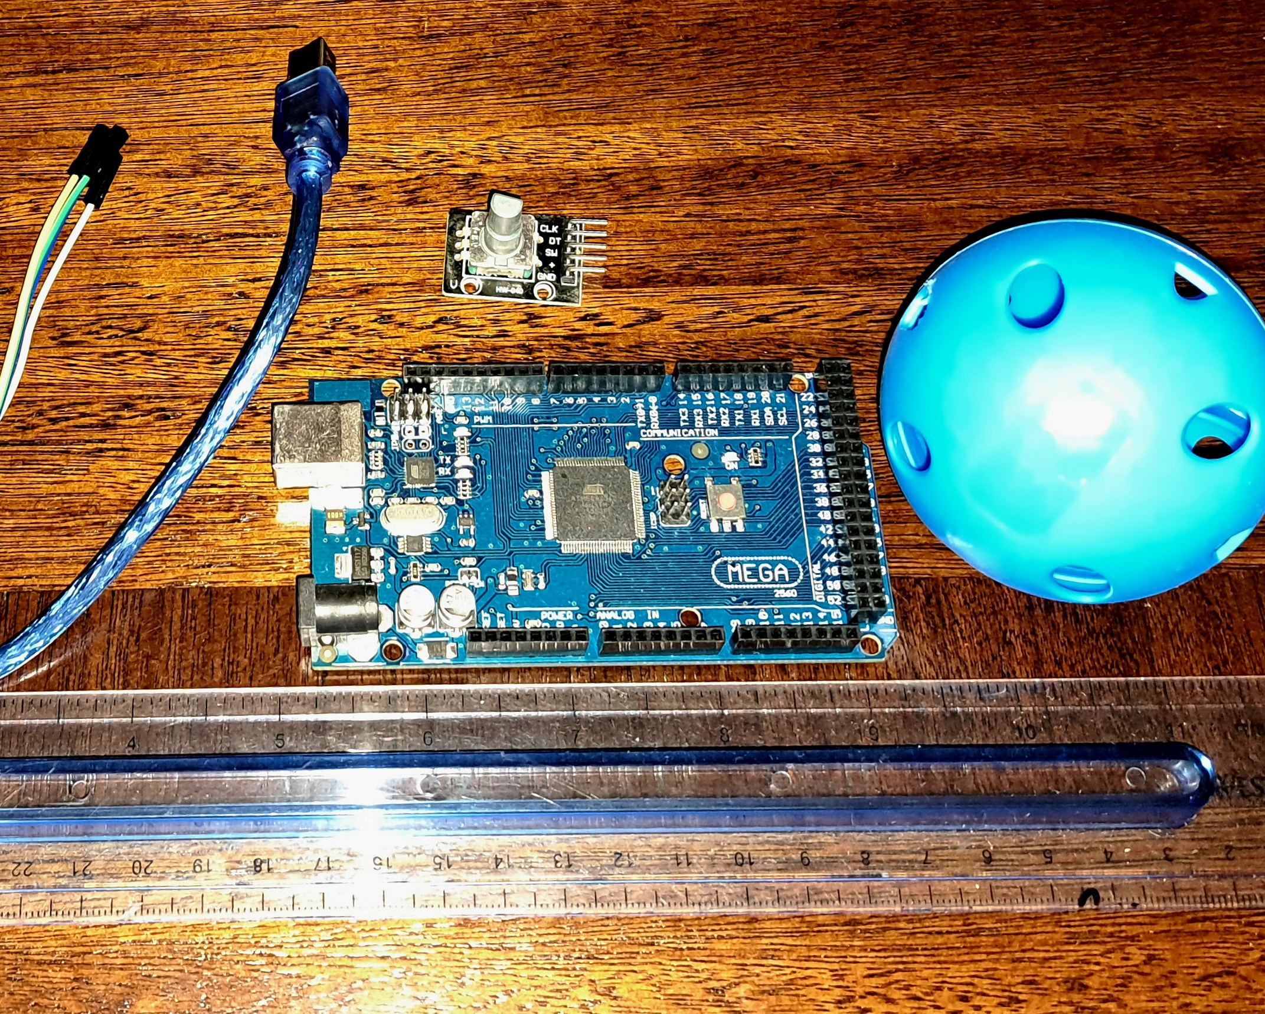
MATERIALS LIST
Arduino Mega 2560
Rotary Encoder Part KY-040
Male to Female Wires
USB cable to connect Arduino
Object to attach onto rotary encoder
Ruler or tape measurer

Slide 6
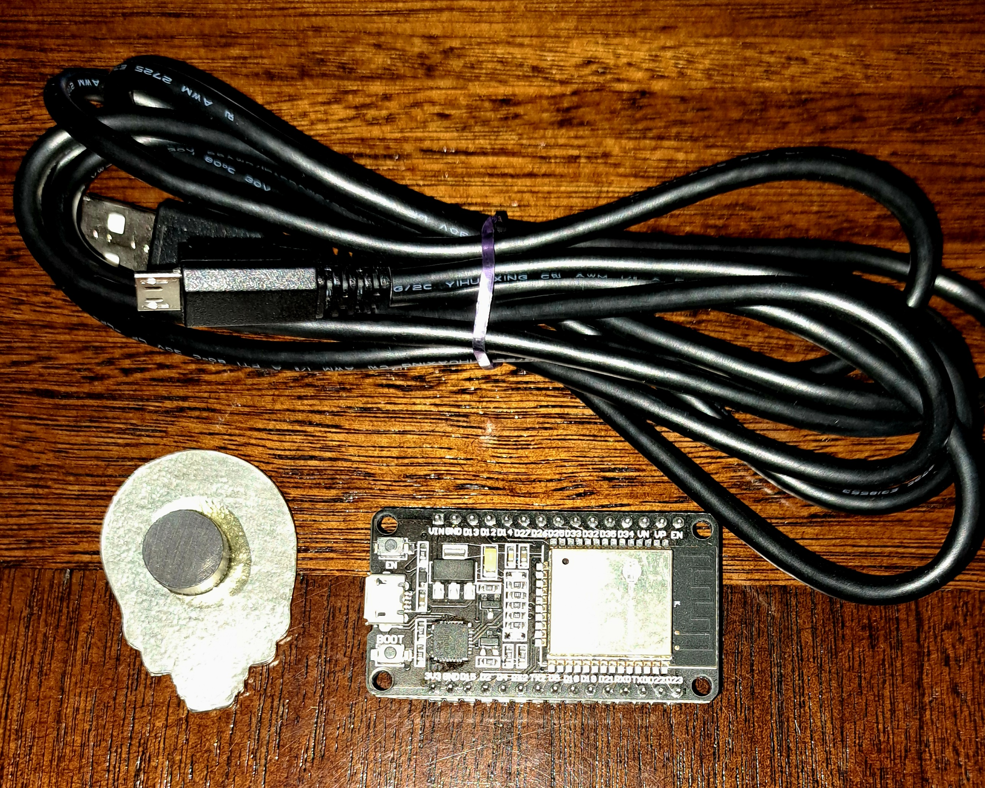
MATERIALS LIST
ESP32 microprocessor
Micro-USB cable
Magnet

Slide 7
MATERIALS LIST- REQUIRED SOFTWARE
Microsoft Excel installed and running.

Slide 8
MATERIALS LIST- REQUIRED SOFTWARE
Arduino IDE installed and running.

Slide 9
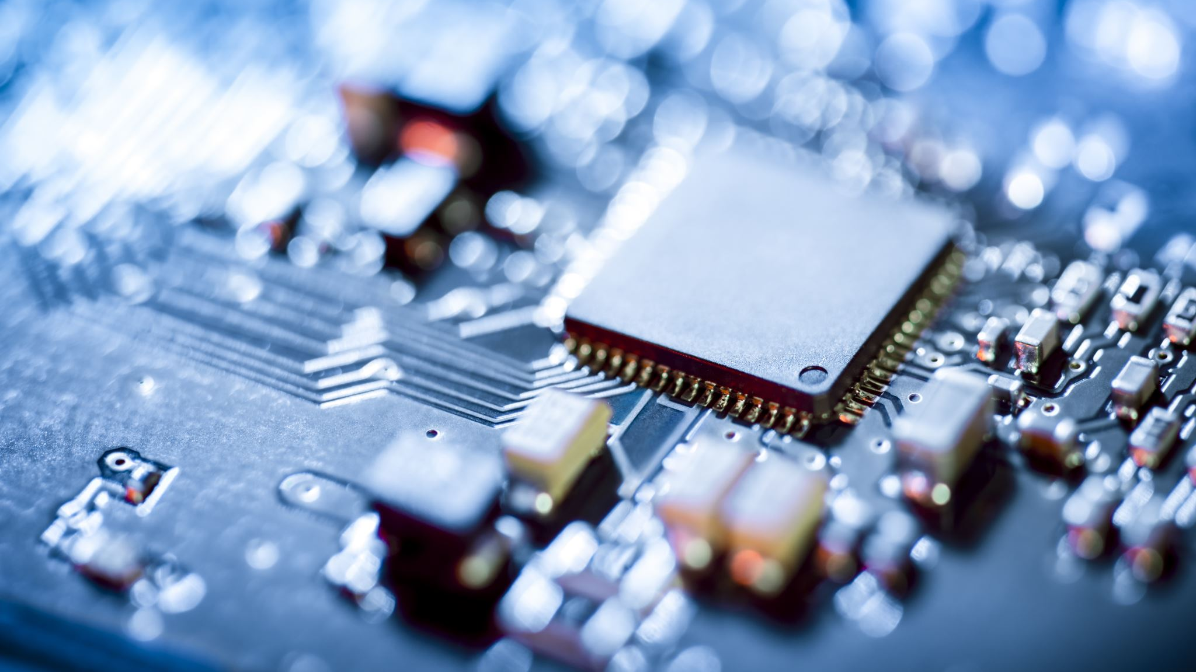
PRECISION OF AN ULTRASONIC SENSOR
An ultrasonic sensor is a device that will measure the distance of an item by emitting ultrasonic sound waves toward an item and then determines its distance by detecting the reflected waves. Determining the precision of the data collecting sensor is vital as you want accurate readings and sensors are known to drift over time.

Slide 10
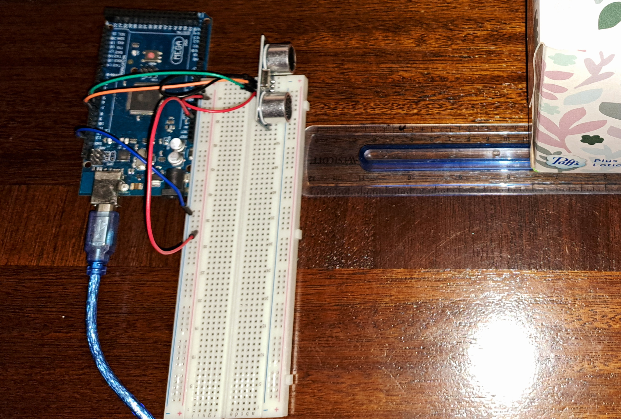
EXPERIMENTAL SET-UP- PRECISION OF AN ULTRASONIC SENSOR EXPERIMENT
Materials List:
Mega 2560 Board
Ultrasonic sensor HC-SR04
Male to Male Wires
Breadboard
Ruler or tape measurer
Large and flat object to act as obstacle

Slide 11
RAW DATA- PRECISION OF AN ULTRASONIC SENSOR EXPERIMENT
Screenshot of Serial Monitor from Arduino IDE showing raw data.

Slide 12
DATA COLLECTION- PRECISION OF AN ULTRASONIC SENSOR EXPERIMENT
Trial | Ruler Distance (cm) | Total Roundtrip Distance (m) | Time from Serial Monitor (microseconds) | Roundtrip time (s) | Velocity = distance/time (m/s)
1 | 8 | 0.16 | 573 | 5.73e-4 | 279
2 | 9 | 0.18 | 640 | 6.40e-4 | 281
3 | 5 | 0.10 | 375 | 3.75e-4 | 267
4 | 10 | 0.20 | 833 | 8.33e-4 | 240
5 | 16 | 0.32 | 1077 | 10.77e-4 | 297

Slide 13
DATA ANALYSIS- PRECISION OF AN ULTRASONIC SENSOR EXPERIMENT
Average velocity from table
*Percent difference where $v_{sound}=343 m/s$
$$v_{avg}= \frac{v_{1}+v_{2}+v_{3}+v_{4}+v_{5}}{5}$$
273
m/s
$$Percent difference = \frac{\left|v_{avg}−v_{sound}\right|}{v_{sound}}×100$$
20
%

Slide 14
CONCLUSION PRECISION OF AN ULTRASONIC SENSOR EXPERIMENT
Discuss the results and comment on the source of errors.
Answer:
I had to adjust my set-up several times, as my readings were all over the place. I had to raise my ultrasonic sensor up, as the sound was bouncing back and picking up itself.
What is the dependence of temperature, humidity, and atmospheric pressure on the speed of sound? How does it affect the results?
Answer:
The speed of sound can be affected several ways including humidity, temp, pressure, etc. The humidity reduces the air density, therefore allowing it to travel faster, and heat makes sound travel faster as well.

Slide 15
FREE FALL MOTION
After we have the precision of our ultrasonic sensor determined, the sensor is then used to decide the gravitational accelerations of a free-falling object.

Slide 16
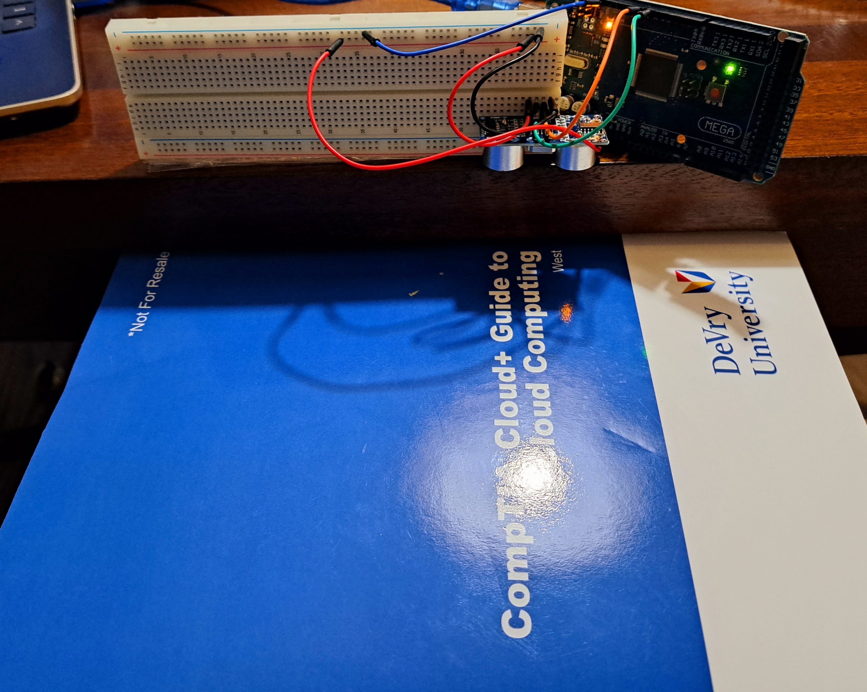
EXPERIMENTAL SET-UP FREE FALL MOTION
Materials List:
Mega 2560 Board
Ultrasonic sensor HC-SR04
Male to Male Wires
Breadboard
Large and flat object that is not susceptible to air resistance to undergo free fall motion

Slide 17
SERIAL MONTIOR FREE-FALL MOTION
Screenshot of raw data showing the start of the fall and end of the fall of one trial.

Slide 18
EXCEL TABLE FREE-FALL MOTION
Showing the values in the Excel table for a single trial showing the fall distance in centimeters and meters as a function of time

Slide 19
EXCEL GRAPH FREE-FALL MOTION
Excel graph for a single trial showing the fall distance as a function of time.

Slide 20
DATA COLLECTION FREE-FALL MOTION
Trial | x² coefficient value from curve fitting | Acceleration (m/s²) = 2* (x² coefficient)
1 | 36.16 | 72.32
2 | 8.23 | 16.46
3 | 8.18 | 16.36
4 | 7.58 | 15.16
5 | 7.27 | 14.54

Slide 21
DATA ANALYSIS FREE-FALL MOTION
Average acceleration from table
*Percent difference with $g=9.8 m/s^{2}$
$$a_{avg}= \frac{a_{1}+a_{2}+a_{3}+a_{4}+a_{5}}{5}$$
26.968
m/s
$$Percent difference =\frac{\left|a_{avg}−g\right|}{g}×100$$
170
%

Slide 22
CONCLUSION FREE-FALL MOTION
Discuss the results and comment on the source of errors.
Answer:
I had to try several different drops to be able to have a plot that was correct. Even then I had to remove two points.
How much variation is there from trial to trial? What does this indicate about the uncertainty of the result?
Answer:
I didn’t have much difference in the results when I was able to finally get everything set up and executed correctly.

Slide 23
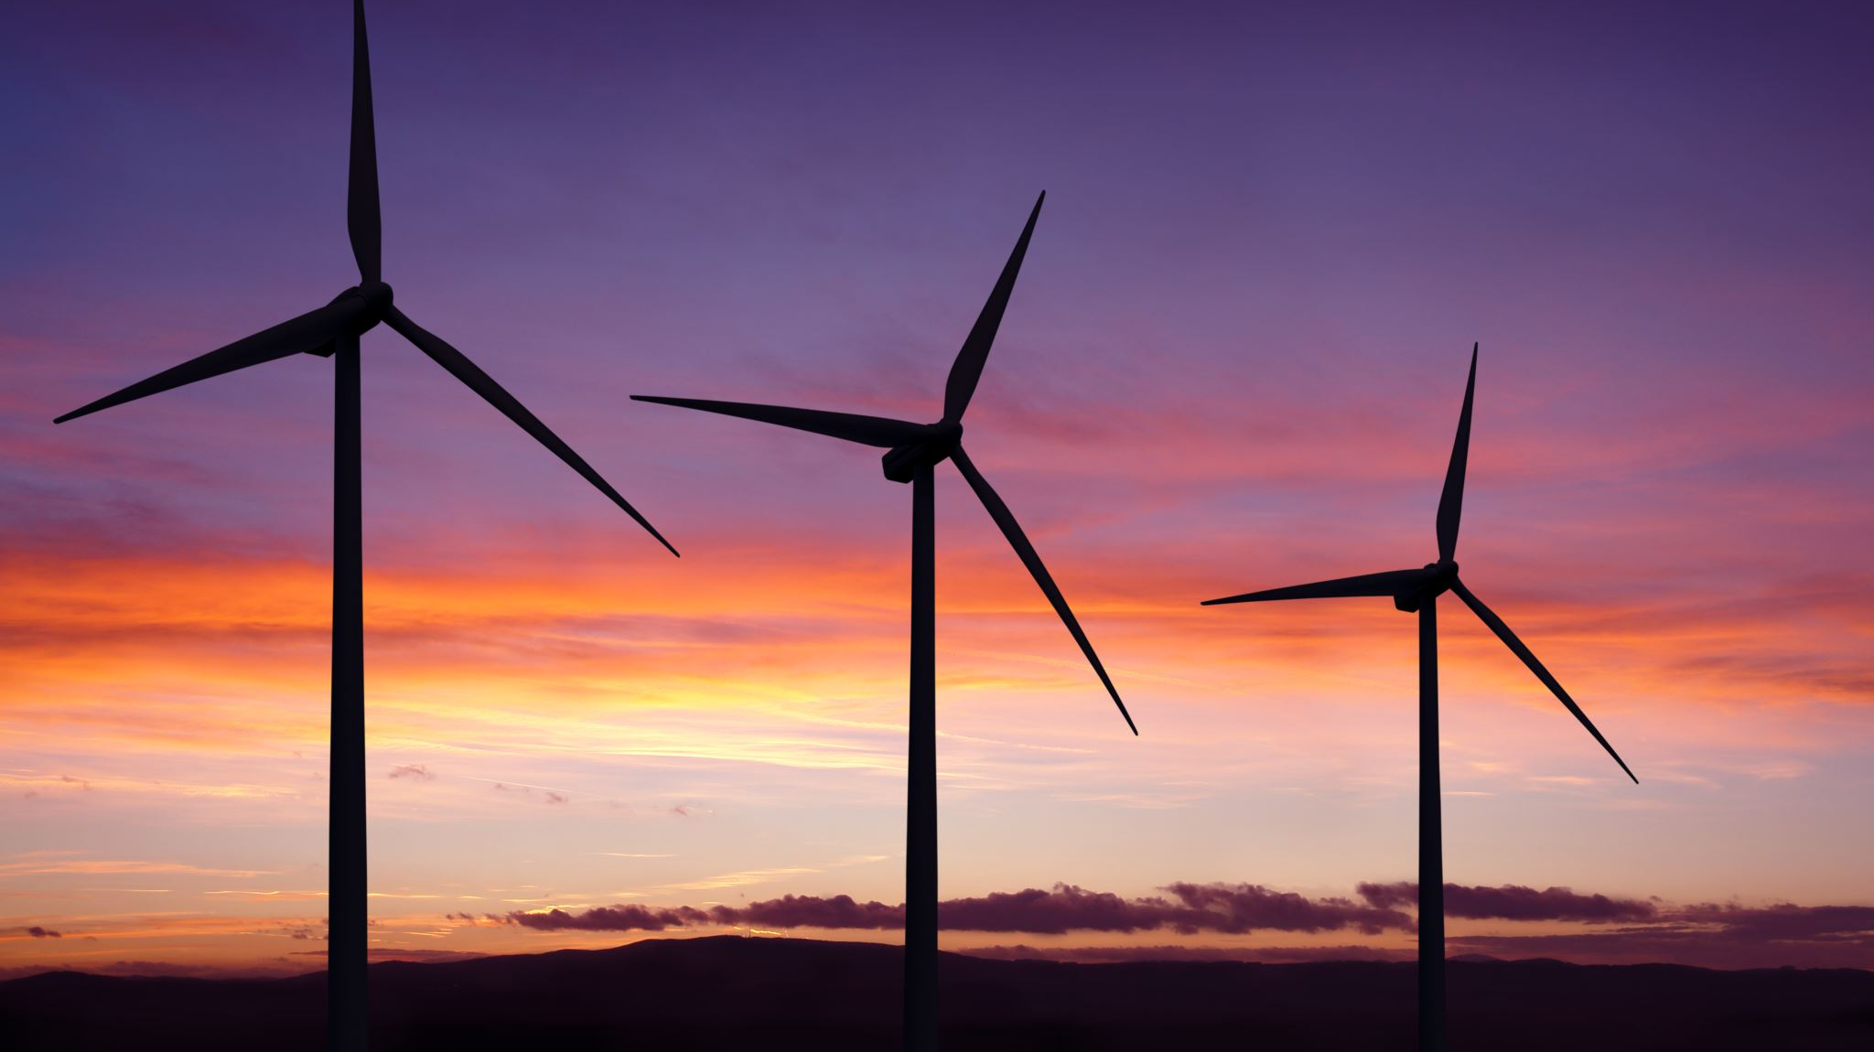
CONSERVATION OF ENERGY
The data gathered from the free-fall experiment is used to observe the transformation of potential energy into kinetic energy. The total mechanical energy gives you understanding into the conservation of energy.

Slide 24
EXCEL TABLE CONSERVATION OF ENERGY
Excel table for a single trial showing the fall distance in centimeters and meters as a function of time with the values generated for kinetic energy K, potential energy U, and total mechanical energy E.

Slide 25
EXCEL GRAPH CONSERVATION OF ENERGY
Excel graph for a single trial showing the plots of the kinetic energy K, potential energy U, and total mechanical energy E as a function of time.

Slide 26
DATA ANALYSIS CONSERVATION OF ENERGY
Theoretical value of final velocity
Final velocity from experimental data (or largest velocity)
Percent difference
$h=y_{final}−y_{initial}=$
0.8846 - 0.0005=0.8841 m
$v_{f}=\sqrt{2gh}=$
$$\sqrt{2 ∗9.8∗.8841=4.16m/s}$$
$v_{experimental}$ =
4.84
m/s
$$Percent difference =\frac{\left|v_{f}−v_{experimental}\right|}{v_{f}}×100$$
-1630
%

Slide 27
CONCLUSION CONSERVATIN OF ENERGY
Discuss the key characteristics of the plot. Consider the points when potential energy U is maximum, U is minimum, kinetic energy K is maximum, K is minimum and when U and K are the same value. What is the significance of these points?
Answer: : I had to redo my experiment due to leaving out some of the data from the previous week. In this trial, my ‘U’ the potential energy was slightly higher at the very beginning and the lowest was in the middle. It stayed almost the same all the way, slightly differed. The total energy was at the max in the beginning of the graph, it decreased a great deal and ‘K’ and total energy went back up to where they were almost the same. I’m saying the “U” stayed almost constant because of the weight.

Slide 28
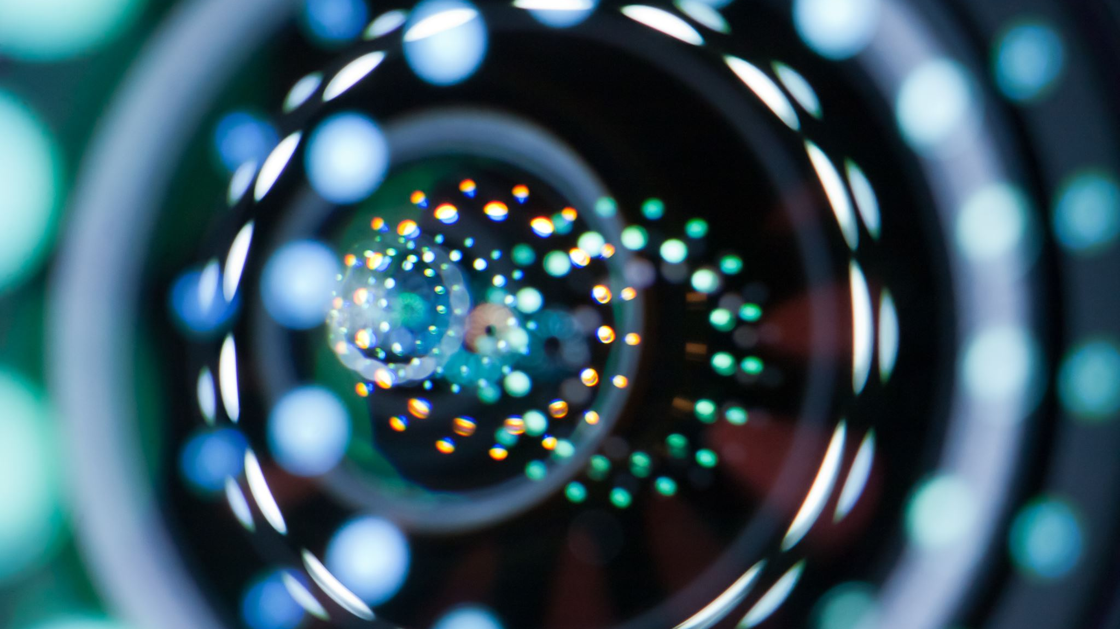
CIRCULAR MOTION WITH ROTARY ENCODER
Now we apply what we have learned about circular motion. This will assist in understanding the relationship between radial displacement and linear displacement using the rotary encoder.

Slide 29
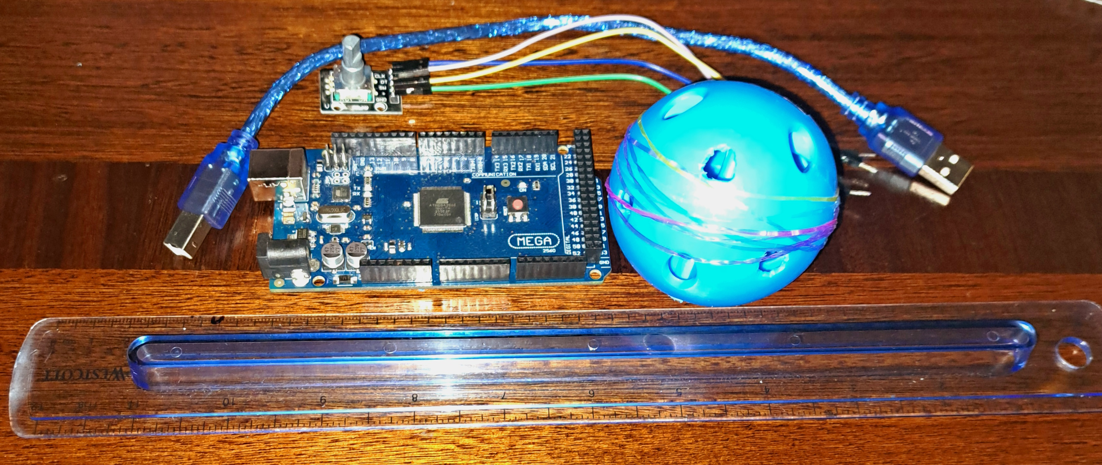
EXPERIMENTAL SET-UP CIRCULAR MOTION WITH ROTARY ENCODER
Materials List:
Mega 2560 Board
Rotary Encoder Part KY-040
Male to Female Wires
Object to attach onto rotary encoder Ruler or tape measurer

Slide 30
RAW DATA CIRCULAR MOTION WITH ROTARY ENCODER
Screenshot of Serial Monitor from Arduino IDE showing raw data.

Slide 31
DATA COLLECTION CIRCULAR MOTION WITH ROTARY ENCODER
Object diameter: d =
Object radius: r =
Number of pulses for one revolution: x =
Resolution = $\left(\frac{1 }{x } \frac{Revolution}{pulses}\right)∙\left(\frac{2∙π radians}{1 Revolution}\right)=$
6.36
cm
3.18
cm
29
0.217
Radians/pulse

Slide 32
DATA ANALYSIS CIRCULAR MOTION WITH ROTARY ENCODER
Trial | Number of pulses N | Encoder distance r$∙Resolution∙$ N | Measured distance with ruler | Percent difference
1 | 25 | 17.25cm | 30cm | 42.5%
2 | 51 | 35.19cm | 30cm | 17.3%
3 | 64 | 44.16cm | 42cm | 5.14%
4 | 17 | 11.90cm | 10cm | 19%
5 | 33 | 22.77cm | 20cm | 13.85%

Slide 33
CONCLUSION CIRCULAR MOTION WITH ROTARY ENCODER
Discuss the results and comment on the sources of error.
Answer:
I had a little difficulty getting my ball to fit snug on the rotary encoder at the beginning. My first data trial was when I had just got it positioned correctly and began tuning. I had to place rubber bands around my ball despite trying different materials to create enough friction to get it to rotate on the table by itself. After I had everything figured out, I enjoyed gathering the different data with varied lengths.
What are some applications of this measuring technique? Could this measuring system be used to measure surfaces that are not flat?
Answer: I am using my Bluetooth computer mouse which has a scrolling wheel, and the wheel uses a rotary encoder. It then will measure the movement and sends the data to the computer.

Slide 34
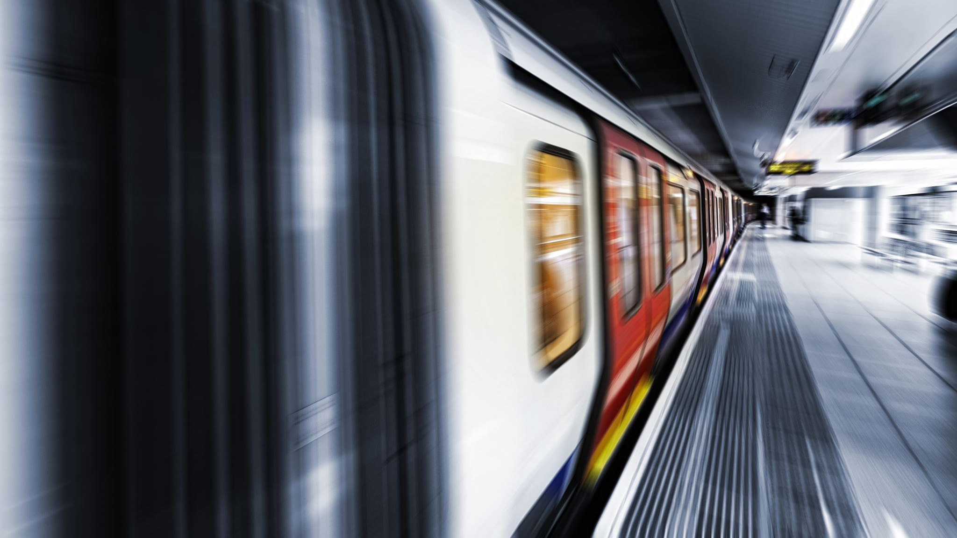
HALL EFFECT
In this part of the experiment, we can see the Hall effect by using the ESP32 microcontroller to measure the proportional voltage under the effect of a magnetic field. The measurements from the sensor can increase or become negative depending on the magnet pole facing the sensor.

Slide 35
EXPERIMENTAL SET-UP HALL EFFECT
Materials List:
ESP32 microprocessor
Micro-USB cable
Magnet

Slide 36
RAW DATA HALL EFFECT
Screenshot of Serial Monitor from Arduino IDE showing raw data.

Slide 37
EXCEL GRAPH HALL EFFECT
Include Excel graph for a single trial of data plotted as a function of time.

Slide 38
CONCLUSION HALL EFFECT
Discuss the results and comment on the sources of error.
Answer:
When bringing my magnet down towards the sensor the voltage went up, when raising back up it receded. When I flipped my magnet non the other side and brought it back down close to the sensor it almost stayed the same at 1. I tried two different magnets and they both had the same results.
Describe how the Hall sensor works. What are some applications for the Hall effect sensor?
Answer:
Hall sensors work by measuring changing voltage when in the presence of a magnetic field perpendicular to the direction of the current flow. A lot of industrial settings use Hall sensors, they can be used for positions sensing, monitoring flow rates, water supply and treatment, and can also be found in the oil processing field.

Slide 39
CHALLENGES
I had issues with my placement of the ultrasonic sensor therefore it was throwing my data off. I was able to readjust and proceed with the experiment.
I also found some difficulty with the rotary encoder fitting snug enough on my object so I could get complete, smooth rotations.

Slide 40
CAREER SKILLS
This project involved a lot of attention to detail, as well as critical-thinking and problem solving.
It involved troubleshooting, finding solutions, and proceeding with the experiment.
Knowledge of hardware set-up and programming.

