Slide 1
CEIS 106 Introduction to Operating Systems Project
Chandra Atchley December 2021

Slide 2
Introduction
While taking the Introduction to Operating Systems class I learned a lot about the Linux Operating System.
This project will show distributions of Linux, shell scripts, administrative tasks, file systems, networking, security, troubleshooting, and performance.

Slide 3
MODULE 1

Slide 4
Introduction to LInux
Operating systems manage and contain all the programs and applications that a computer or mobile device can run. It is in fact the most important software that runs of a computer. It manages the computer’s memory and processes, as well as all the hardware and software functions. Without an operating system, a computer is useless. Having an operating system is vital because it allows you to communicate with the computer without knowing how to speak the computer’s language.

Slide 5
Introduction to Linux / Downloading LInux
Accessed Linux Ubuntu OS through Azure Virtual Machine.
In Azure you must properly start and shut down the Virtual Machine.

Slide 6
Module 2

Slide 7
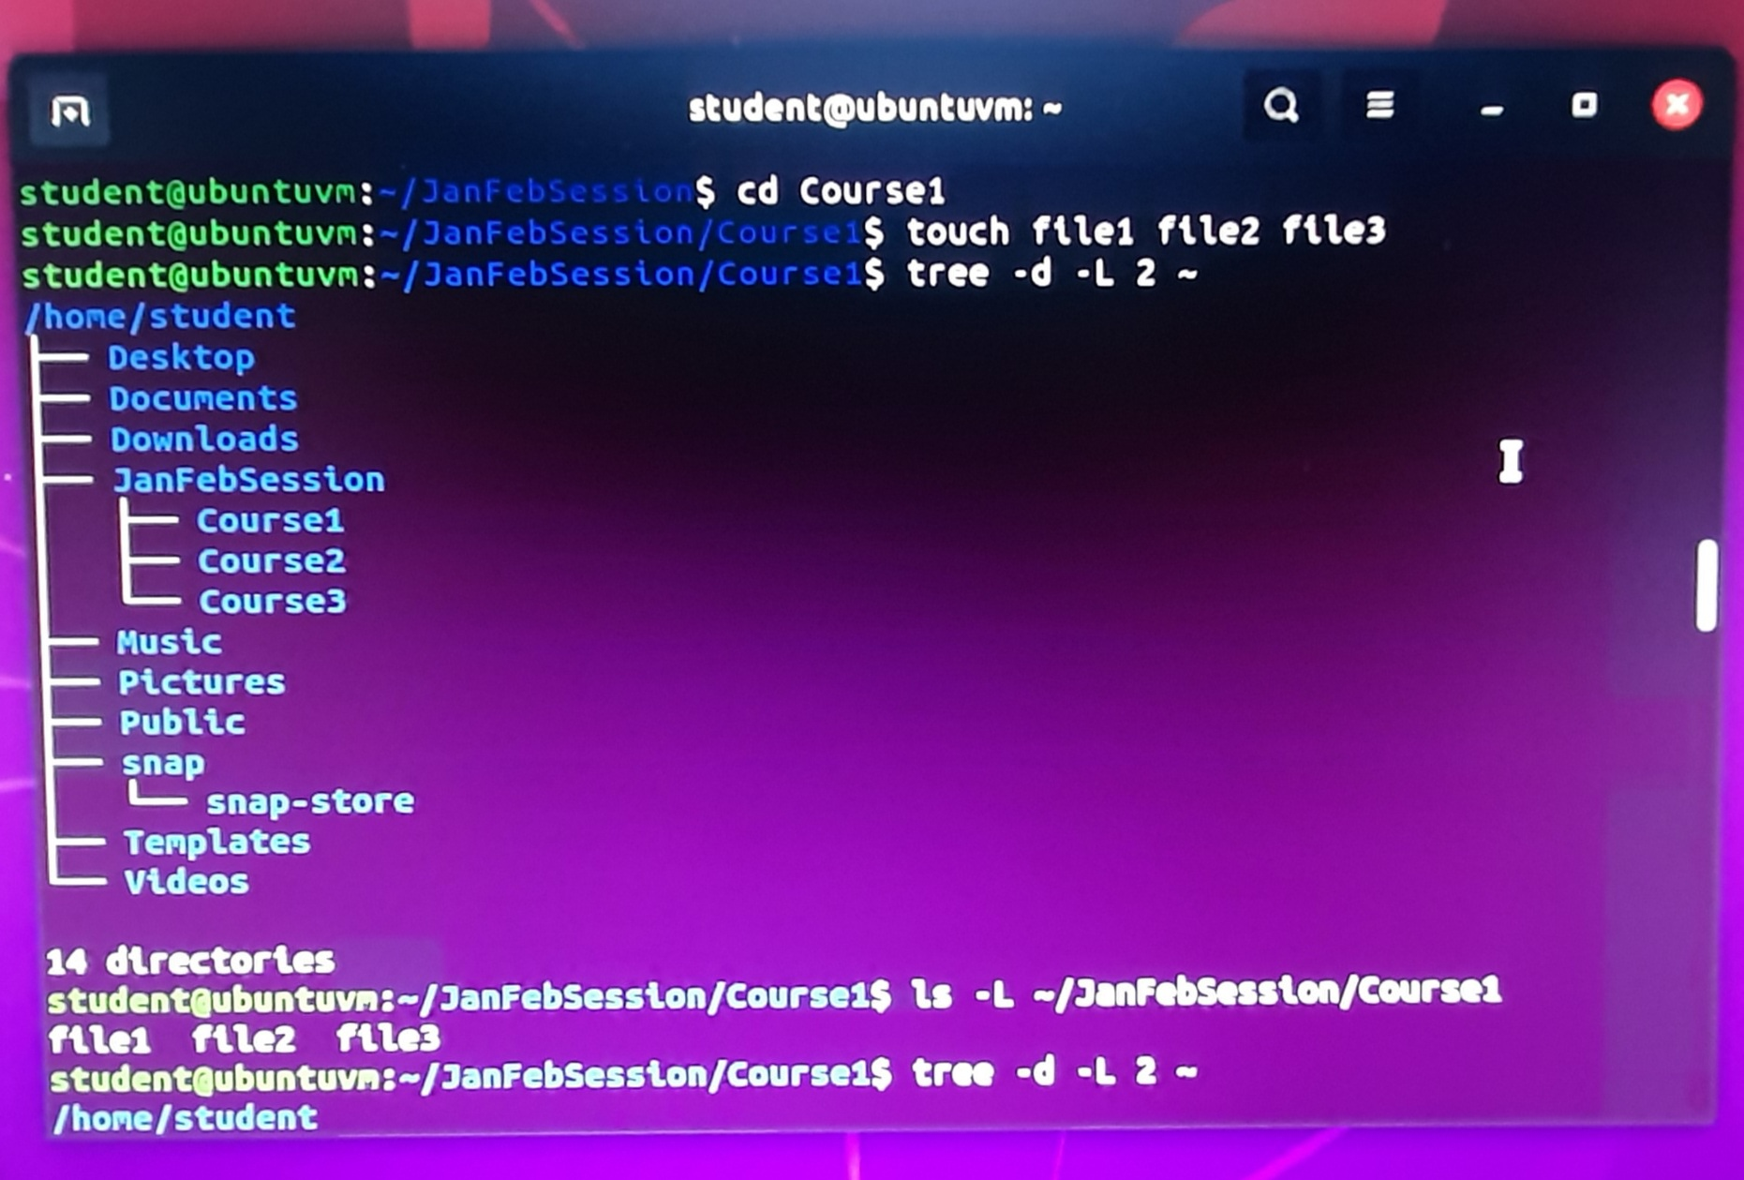
Linux filesystem hierarchy
Adding Subdirectories
Used the command tree –d –L 2, to display the subdirectories of the home directory.
After verifying the current directory, pwd, used tree –d –L 3 /home to display the home directory tree.
Created a subdirectory by entering the mkdir JanFebSession command.
Next I created a Course1 subdirectory by entering the mkdir Course1 command and repeated it with Course2 and Course3.
I entered ls –l `/JanFebSession/Course1 to list the three new files: file1, file2, and file3.

Slide 8
Linux file systems- Remove directories & files
Removing Subdirectories and Files
I used the commands remdir MarAprSession/Course3 and rm MarAprSession/Course1/file3 to remove Course3 subdirectory and file3 file from the directory I created.
I then used the command tree JanFebSession MarAprSession to verify that both were removed.

Slide 9
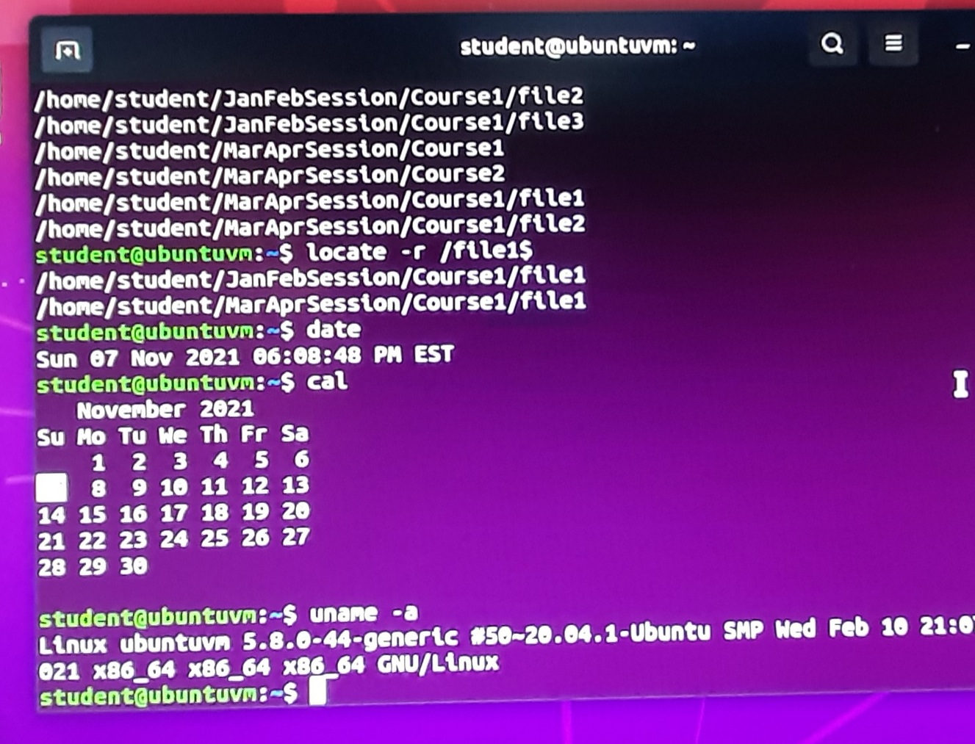
Linux file systems- locate directories and files
I used the command r find ` -iname course* -type d to look for directories whose names start with the “course” string in my home directory.
To locate all the files on my hard disk I used the command find ` -iname file[1,2,3].
I also used the command sudo updatedb to update the locate database often so that files and subdirectories that are recently will not be part of the search result.
To search for an exact directory or file name, use the –r option and the $ character at the end of the search term as in the locate –r /file1$ command.

Slide 10
MODULE 3

Slide 11
Linux Shell scripts-Change script file permissions
Linux shell scripts- create shell script/permissions
A shell script in Linux is a file that contains Linux commands. Within the shell the files have permissions, they are: r- Read, gives the group permission to read the file.
w- Write, gives the group permission to edit the file.
x- Execute, gives the group permission to execute the file.
I used the command bash todolist to call the bash executable to interpret and execute the script. As seen in the photo below.
Using the command chmod 755 to make scripts executable. The following command 755 gives read and execute permissions to everyone.
Then type the command ls –l todolist to verify the file permissions.
Enter ./todolist to execute the script by calling its name.

Slide 12
Linux shell scripts- Set the PATH variable
The PATH variable is an environment variable that contains an ordered list of paths that Linux will search for executables when running a command.
Use the command echo $PATH to see the current directory.
To add home directory to the todolist script I used PATH=$PATH:/home/student
Use the command $PATH to verify again, then to execute enter todolist then 1.school. 2. work. 3. family.

Slide 13
Linux shell scripts- permanent path variable
To make a PATH variable permanent you must modify the hidden .bashrc file.
First use nano .bashrc to open the file..
Then add the command PATH=$PATH:/home/student to the end of the file.
To active the change, use the source .bashrc command.
And the final step is to open a new terminal window, run the todolist script to make sure it carried over correctly.

Slide 14
Module 4

Slide 15
Linux Administrative tasks- adding users
To add a new user, enter command sudo useradd –m –s /bin/bash mary
To create a group for students, use the command sudo groupadd students
Then to add your own user account and marys newly created account to the ‘students’ group use: sudo usermod –a –G students student and sudo usermod –a –G students mary.
Use the -3 option to display the last 3 lines of the file to verify adding users and groups.

Slide 16
Linux administrative tasks- Test user and group settings
Enter the command sudo chgrp students todolist to change the ownership of the todolist script.
Use the command ls –l todolist to verify.
Enter sudo chmod 750 todolist to modify permissions of the todolist script for other usrs to read and execute.
Log in with new user and open new terminal and enter command nan.bashrc and open the file.
To active the changes use the command source .bash.rc

Slide 17
Linux administrative tasks- remove users and groups
To remove the user mary, use sudo userdel –r mary. Use the same command for the user john, sudo userdel –r john. Pictured (right) are before and after screenshots of added users and deleted users.
To remove the group use sudo userdel –r.
To change group ownership of todolist back to your primary group use the command sudo chgrp student todolist
To verify the changes, use ls –l todolist command.

Slide 18
Module 5

Slide 19
NETWORKING- Discover host IP configurations
To display your IP address enter ip addr
To display the default gateway IP address enter ip route
The IP address in the photo below is 192.168.1.104
The IP address of the default gateway is 192.168.1.1
The IP address of its DNS Server is 192.168.1.1

Slide 20
NETWORKING-
Use network utilities
The DHCP message shown in the output of the sudo dhclient –v –r eth0 command is DHCPRELEASE
The DHCP messages are in the output of the sudo dhclient –v eth0 command are DHCPDISCOVER, DHCPREQUEST, and DHCPPACK
Use ifconfig to display IP addresses assigned to all network interfaces.
Then use sudo ifconfig eth0 down to disable the eth0 interface.
Enter ifconfig eth0 to verify the status is disabled then again after enabling the interface.
To enable the eth0 interface use sudo ifconfig eth0 up.

Slide 21
Module 6

Slide 22
Security, Troubleshooting, & performance
Security is crucial and you should protect yourself on every avenue possible,
First is basic measures, having a password lock on your computer along with a lengthy, secure password/phrase.
Never leave your computer unattended in a public place or around sources you don’t trust.
Minimize the number of network services running.
Limit the time you are logged in as the root user, especially if you are sharing a computer. This would help reduce the chance that someone else access your terminal.
Next I would encrypt my hard drive (FDE-full disk encryption) this way in case your laptop is stolen they can’t gain access without my FDE password,
Always make sure operating systems and applications are up to date.
The Linux kernel includes a firewall component called iptables, which gives you a powerful ways to mange network traffic and keep out many sorts of cyberattacks.
And last, running vulnerability scanner software can help detect vulnerabilities in databases.

Slide 23
Security, troubleshooting, performance
Monitoring the Linux process:
The performance of Linux can be diminished by things such as your RAM, CPU usage, storage speed (can be HDD or SSD), or connection to the internet.
Inspecting the performance of the Linux system is key to keeping a smooth running operation.
Enter htop to launch the utility program that monitors Linux in real time.
To close a process, use shortcut k and choose 15 sigterm to close highlighted process.

Slide 24
Security, troubleshooting, performance-Monitor network bandwidth usage
To see user connection time, use command ac or use ac –d for daily use. To see each user’s time per day use ac –dp.
To see previously used commands, use lastcomm to display information.
If you see an S flag on your output that means the command was done by a ‘super user’.
Using command sa –m shows the number of processes and CPU minutes on a per-user.
To turn off accounting enter sudo accton off.
To view bandwidth use, enter sudo iftop to start iftop utility.
To exit press q to close the iftop utility.

Slide 25
Challenges a few of the challenges I came across were:
I came into this brand new, so just understanding how it all works was quite challenging,
Several times I ran into an issue with my virtual machine not connecting but was able to troubleshoot it and overcome it.
Also just trying to memorize all the commands and their actions. So repetitive use helped a lot there.

Slide 26
CAREER
Linux is a necessity in the IT field position in which I hope to obtain one day. I hope to further my knowledge in Linux and Kali Linux and then obtain the certifications to add to my resume. There is so much to learn in Linux OS because it changes daily, but I am eager to learn as much as possible.

Slide 27
CONCLUSION
This class was a challenge for me but also a wonderful introduction and filled with great information. I will carry all of this with me into the next set of classes. Taking this Introduction to Operating Systems help lessened my fears coming into this as a novice.

